Slide 1
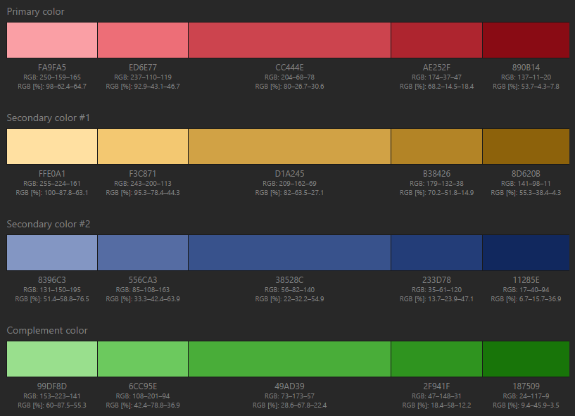
Colour scheme
http://paletton.com/#uid=75A0+0kloqebKE5h6utphmqtrhH

Slide 2


One-state DCM for fMRI
Non-linear DCM for fMRI
$$z_{2}$$
A
B
A
C
B
$$z_{1}$$
C
D
Two-state DCM for fMRI
SE
E
E
EE
Excitation
IE
EI
Inhibition
I
I
SI

